Slide 1

Cloud Computing Large-scale Resource Management
Eva Kalyvianaki ek264@cam.ac.uk
Notes:
LOOK at the exam questions

Slide 2
Contents
Mesos: A Platform for Fine-Grained Resource Sharing in Data Center
by B. Hindman, A. Knwinski, M. Zaharia, A. Ghodsi, A. D. Joseph, R. Katz, S. Shenker, I. Stoica from University of California, Berkeley, NSDI 2011.
Omega: flexible, scalable schedulers for large compute clusters
by Malte Schwarzkopf, Andy Konwinski, Michael Abd-El-Malek and John Wilkes, EuroSys 2013.

Slide 3
Background
Data centers are built from clusters of commodity hardware
These clusters run a diverse set of applications: e.g., MapReduce, Data Streaming, Storm, S4, etc
Each application has its own execution framework
Multiplexing a cluster between frameworks improves resources utilisation and so reduces costs

Slide 4
Problem Statement
It is very difficult and challenging for a single framework (application-specific) to efficiently manage the resources of clusters
The aim of the Mesos work is to be able to run multiple frameworks in a single cluster in order to:
maximise utilisation
share data between frameworks

Slide 5
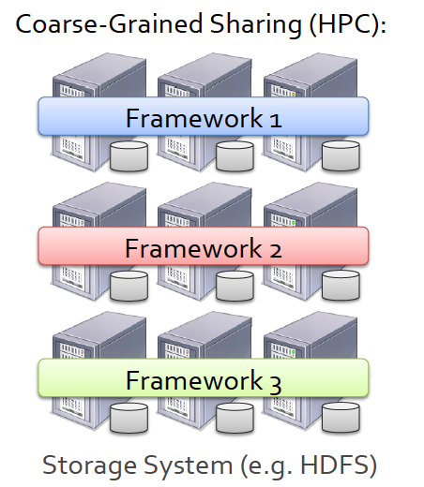
Common solutions for sharing clusters
Statically partition the cluster and run one framework (or VMs) per partition. Disadvantages:
Low utilisation
Rigid partitioning which might not match the real-time changing application demands
Mismatch between the allocation granularity of static partitioning and current application frameworks such as Hadoop.

Slide 6
Mesos
Challenges and Goals:
High utilisation
Support diverse frameworks: each framework will have different scheduling needs
Scalability: the scheduling system must scale to clusters of 1,000s of nodes running 100s of jobs with 1,000,000s of tasks
Reliability: because all applications would depend on Mesos, the system must be fault-tolerant and highly available.
Mesos: a thin resource sharing layer that enables fine-grained sharing across diverse cluster computing frameworks, by giving frameworks a common interface for accessing cluster resources.

Slide 7
Design Elements
Fine-grained sharing:
Allocation at the level of tasks within a job
Improves utilisation, latency and data locality
Resource offers:
Offer available resources to frameworks
Simple, scalable application controlled scheduling mechanism

Slide 8
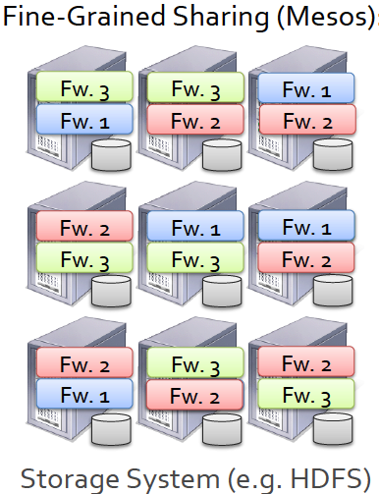
Design Element 1, Fine-Grained Sharing

Slide 9
Design Element 2, Resource Offers
Mesos proposes and uses Resource Offers:
Offer available resources to frameworks and let them pick which resources to use and which tasks to launch
Advantage: keeps Mesos simple, expandable to future frameworks
Disadvantage: Decentralised solutions are not optimal

Slide 10
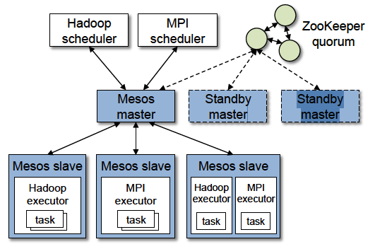
Mesos Architecture

Slide 11
Mesos Architecture, Terminology
Mesos master: fine-grained sharing across frameworks
Mesos slave on each node
Frameworks that run tasks on slave nodes
Framework schedulers
“While the Mesos master determines how many resources to offer to each framework, the frameworks’ schedulers select which of the offered resources to use”.

Slide 12
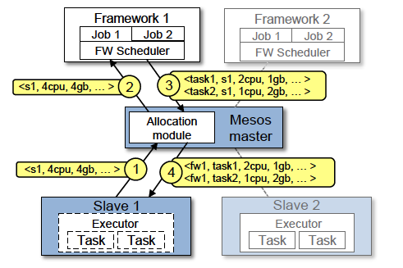
Mesos Resource Offer Example
Notes:
Frameworks can also reject offers so that Mesos is kept simple.
HALF-WAY IN PRESENTATION

Slide 13
Mesos Resource Offers
Frameworks can reject offers when these do not satisfy their constraints in order to wait for ones that do.
But, a framework might have to wait for a long time until it receives an offer that satisfies its constraints and Mesos might be sending these offers to many frameworks → time consuming.
So, Mesos frameworks set their own filters; they specify offers that will always be rejected.

Slide 14
Mesos Architecture Details
Resource Allocation Module
Fair Sharing based on a generalisation of max-min fairness for multiple resources
Strict priorities
Mesos can also (revoke) kill tasks when a greedy framework uses up lots of resources for a long time. Mesos allows the framework a greedy period.
Isolation is achieved using Linux Containers

Slide 15
Mesos Architecture Details (con’t)
Scalable and Robust Resource Offers
Use of filters: “only offer nodes from list L”, “only offer nodes with at least R resources free”, these can be evaluated quickly
Mesos counts resources offered to a framework towards its allocation of the cluster
If a framework takes a long time to respond, Mesos withdraws the offers and asks another framework

Slide 16
Mesos Evaluation
Amazon EC2 with 92 Mesos nodes
A mix of Frameworks:
Hadoop running a mix of small and large jobs based on a Facebook workload
A Hadoop instance running a set of large batch jobs
Spark running machine learning jobs
Torque running MPI jobs
Mesos should: achieve higher utilisation and all jobs should finish at least as fast as in the static partitioning

Slide 17
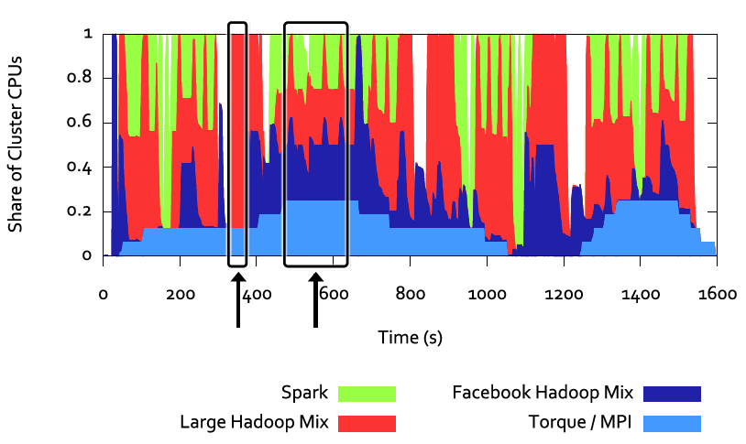
Mesos Performance For all Frameworks
Notes:
At time 350 when both Spark and Facebook Hadoop have no running jobs, the large job-hadoop framework scales up a lot.

Slide 18
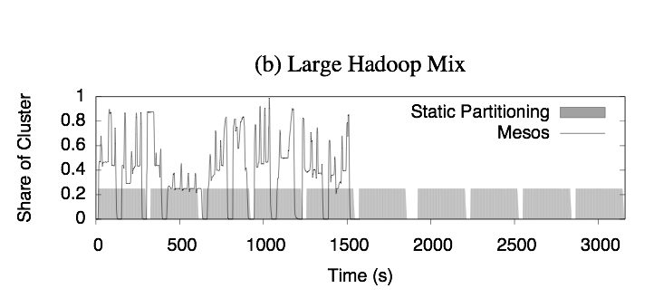
Mesos Performance vs Static Partitioning

Slide 19
Omega: flexible, scalable schedulers for large compute clusters
Challenges:
Google maintains different data centers around the world
Clusters and workloads are growing in size
Diverse workloads
Growing job arrival rates
Need for a scalable scheduler to tackle these challenges

Slide 20
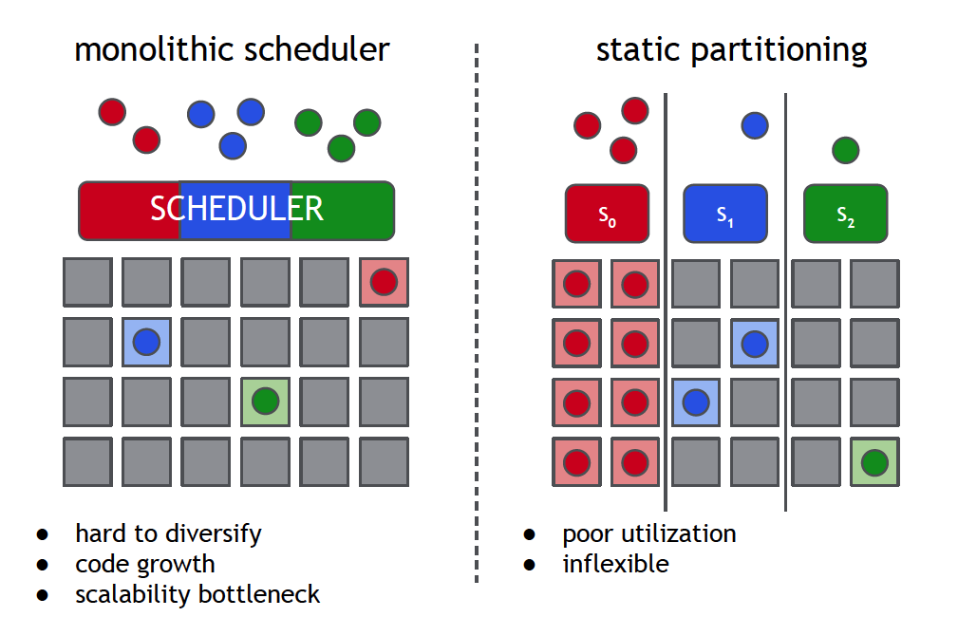
Existing Approaches

Slide 21
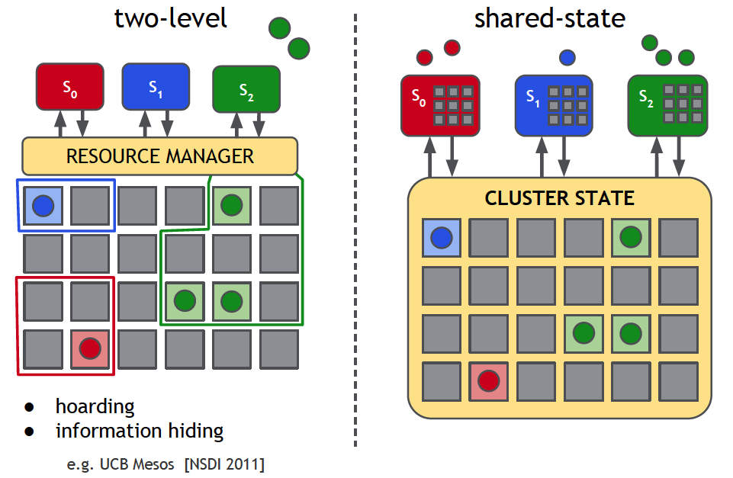
Existing Approach, Mesos revised
Disadvantages:
Pessimistic Concurrency Control: Mesos avoids conflicts by offering a given resource to one framework at-a-time. Mesos chooses the order and the sizes of the offers. One framework holds the lock of the resources for the duration of the decision → slow.
A framework does not have access to all the cluster state. So, it cannot support preemption or getting all resources.
Notes:
Mesos is good when tasks are short-lived and relinguish resources frequently and when job sizes are small compared to the size of the cluster.
But, google cluster workloads do not have these properties and so these approaches do not work well

Slide 22
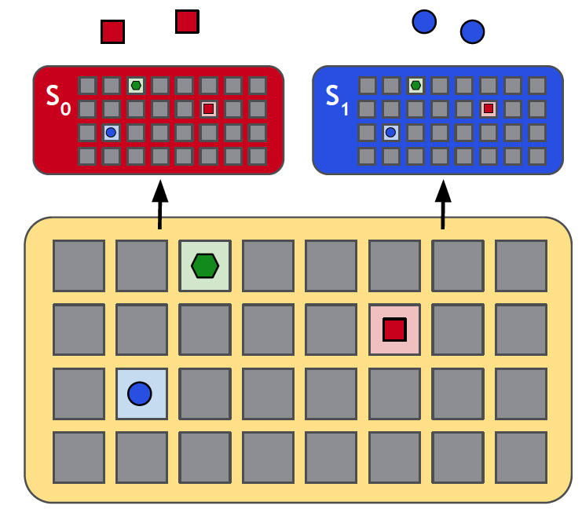
Omega: Shared State, Overview
Cell State: a resilient master copy of the resource allocations of the cluster
No centralised scheduler. Each framework maintains its own scheduler. Each scheduler has its own private, local, frequently-updated copy of the cell state which uses to make decisions.
Notes:
Cell state:

Slide 23
Omega Shared-state Scheduling, Steps
A framework’s scheduler makes a decision
Updates the shared cell state copy in an atomic commit
At most one such commit will succeed
The scheduler resyncs its local copy and if needed re-schedules

Slide 24
Omega Scheduling, Remarks
Omega schedulers operation in parallel
Schedulers typically do incremental transactions to avoid starvation
Schedulers agree on common scale for expressing the relative importance of jobs
Performance viability of the shared-state approach is determined by the frequency at which transactions fail and their costs!!!
“Our performance evaluation of the Omega model using both lightweight simulations with synthetic workloads, and high-fidelity, trace-based simulations of production workloads at Google, shows that optimistic concurrency over shared state is a viable, attractive approach to cluster scheduling. “

Slide 25
Material
Mesos: A Platform for Fine-Grained Resource Sharing in Data Center
by B. Hindman, A. Knwinski, M. Zaharia, A. Ghodsi, A. D. Joseph, R. Katz, S. Shenker, I. Stoica from University of California, Berkeley, NSDI 2011.
Sections 1-3.5, 6-6.1.2
Omega: flexible, scalable schedulers for large compute clusters
By Malte Schwarzkopf, Andy Konwinski, Michael Abd-El-Malek and John Wilkes, EuroSys 2013.
Sections 1-3, 8

